Slide 1
Improved Product Recommendations
Abhinandan Purkait
Chirag Khandelwal
Reetam Nandi
Akash Sharma
Team CAAR

Slide 2
Problem
How to improve product recommendations for customers visiting dell online product store and increase the sales figures ensuring customer satisfaction.

Slide 3
Solution
We gather customer's activity data from different sites example, flipkart, amazon and google using a browser extension (or Ad Networks if available).
The gathered data is used to train a machine learning algorithm which then predicts the preference/priority value for all dell products in the store inventory.
We further improve the predictions by implementing refinement algorithms based on dell's requirements to target the user with specific categories of products
The final recommendations are shown to the user. Maximum customer satisfaction is achieved as the products are of high specifications in minimum customer budget.

Slide 4
Solution
Now we track the user's interaction with the recommended products and refine the recommendations further based on the actions taken like - product added to cart or products checked out.
Interactions with a product on dell.com are used to track product recommendation conversion ratio. This ratio is used to manipulate the recommendations and display popular products.
The customer can provide a feedback in the form of a comment. This comment is run through a sentiment analysis algorithm and the factor is used to improve the predictions.
We provide a dashboard for the marketing and analysis team to visualise the performance of our recommendation engine and its outcomes.

Slide 5
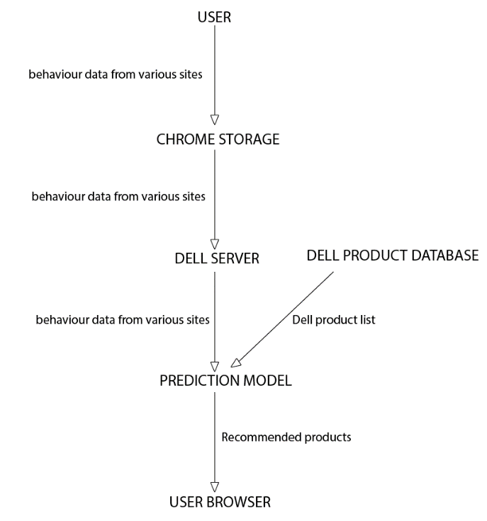
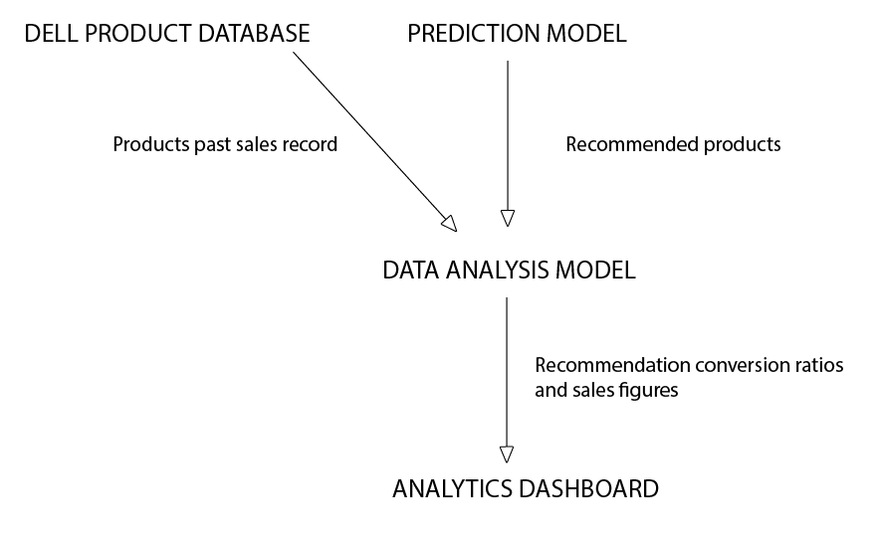
Architecture diagram

Slide 6
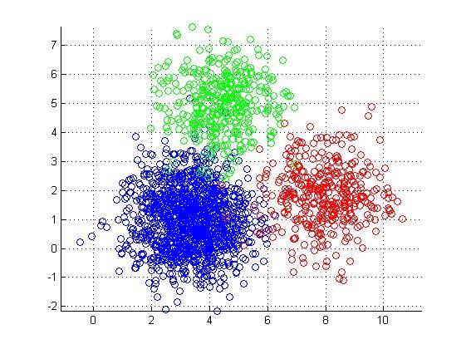
Prediction Algorithm
Priority 1
Priority 2
Priority 3

Slide 7
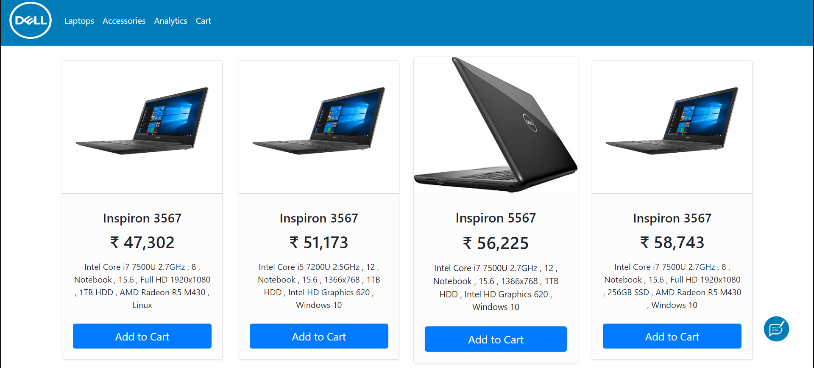
Recommendations

Slide 8
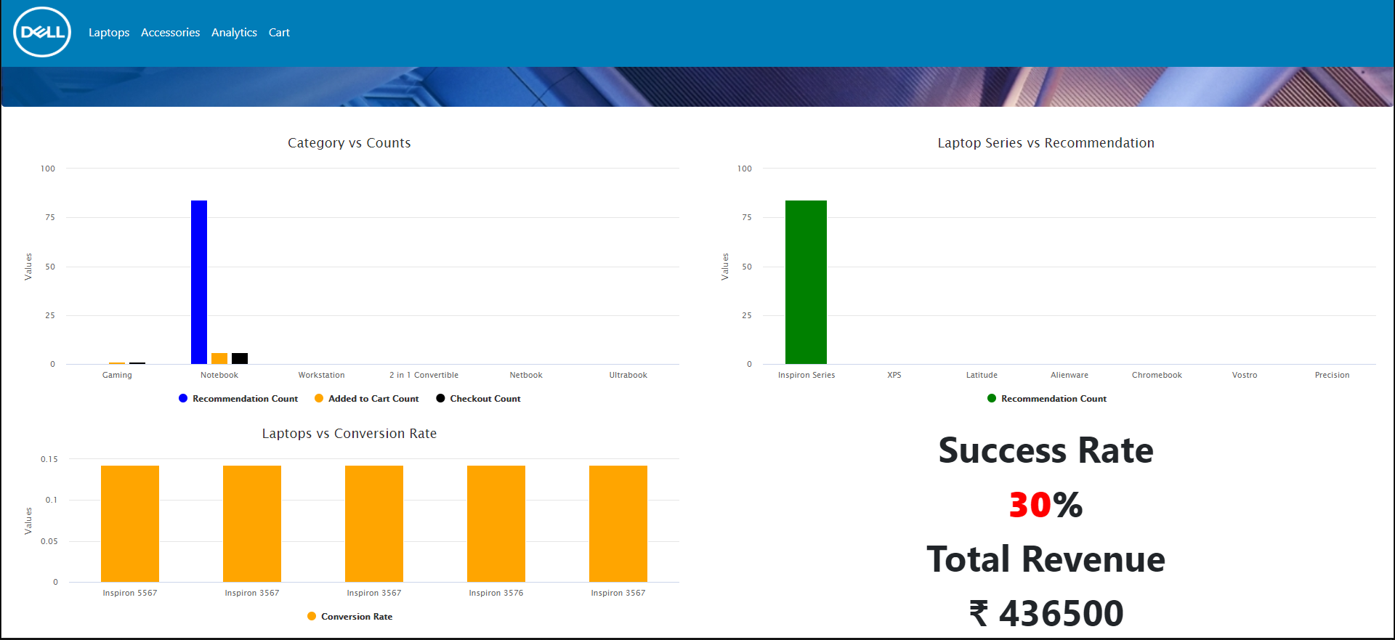
Analytics

Slide 9
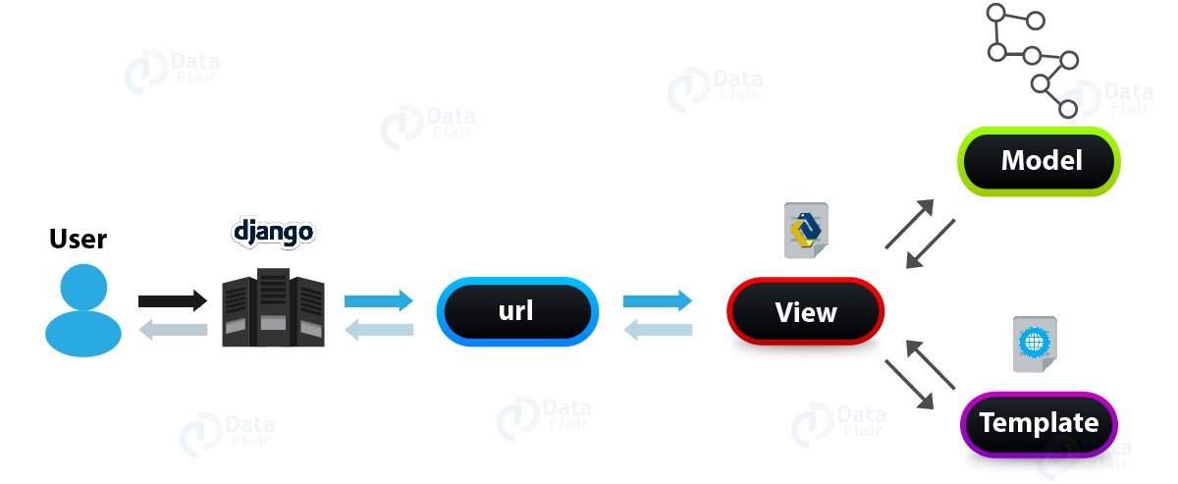
How it all works together

Slide 10
Conclusion
Increased customer satisfaction
Increased sales because of targeted recommendations
Useful data for marketing and analytics team

